Slide 1

Welcome
By
101300367 | Ali Najdat Almohammed Jawish
101401739 | Amar Mohammad Almotlek Almandil
Notes:
*** there we say welcome and so on, introduce our self and wish to them to be save and will ****

Slide 2
UGCA
University Group Chat Application
Where Students and Tutors Meet and Chat
Notes:
** هنا نتحدث قليلا عن البرنامج وما يفعل وما قد يخدم الطلاب به

Slide 3
What is UGCA?
For Students and Tutor,
Who Care about privacy and still want to stay connected with others,
The University Group Chat Application
Is a group chat mobile application
That does not show any private information about its users,
Unlike WhatsApp or Facebook Groups
Our Application lets you use your Student ID instead of mobile number or personal profile to chat with your class mates or tutors.

Slide 4
Content
More details about our application
01
Problem Statement
02
Suggested Solution
03
Competitors
04
Added Value
05
Closing Statement
Notes:
** مرور سريع على النقاط بحيث انهم قد يعلمون محتوى لفيديو

Slide 5
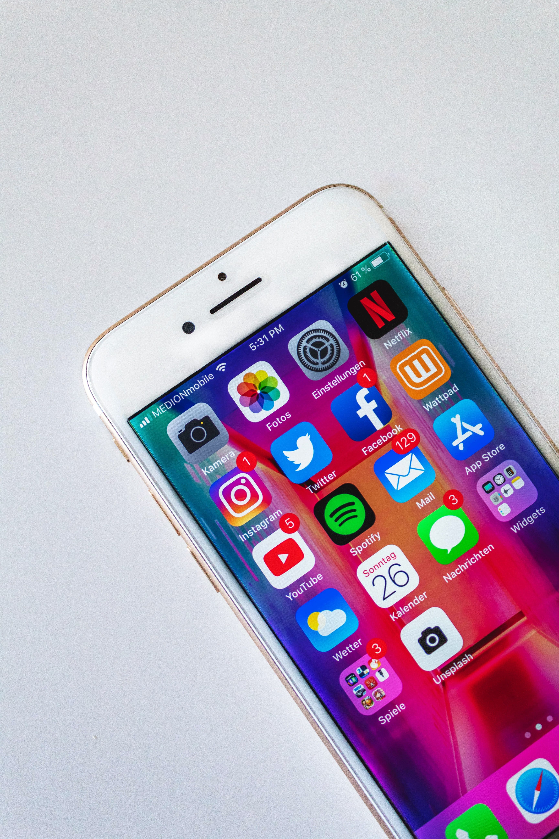
Problem Statement
One of the major difficulties we face as students is to choose between sharing your personal information by giving your mobile number or being left without knowing the updates and news of the class
Students use many platforms to communicate with each other or with the university tutors, ether it was formal communication method or informal.
The multisource of information leads the student to waste time searching for it instead of focusing on learning.
The existence of external unauthorized parties who claim to help students by guiding them, answering their questions, share un-trustable study materials, may leads the student to plagiarism or even worst
Notes:
** هنا نتحدث بعمق ونشعرهم باهميه هذه المشاكل ونتحدث بصيغه نحن كطلاب

Slide 6
Suggested Solution
So here are most important chat application features that provide
an enhanced learning experience from the traditional methods!
Develop an official platform for student and tutors to communicate in a group-based system.
Keep students conveniently connected and updated about registered courses
Improve privacy and security by using student ID as a unique identifier instead of mobile number or email.
Preventing unauthorized persons from joining the system.
Monitoring the groups under the supervision of the university administrators
Centralize the source of information.

Slide 7
Added
Value
What we are trying to achieve by UGCA
Unified platform
For students and tutors with the supervision of the university
Official communication
That can be a reliable alternative to the email
One group for each subject
Student join the groups of subjects automatedly with class mates and tutors

Slide 8




Competitors
#01
#02
WhatsApp
Facebook Group
#03
#04
Telegram
LMS Groups

Slide 9
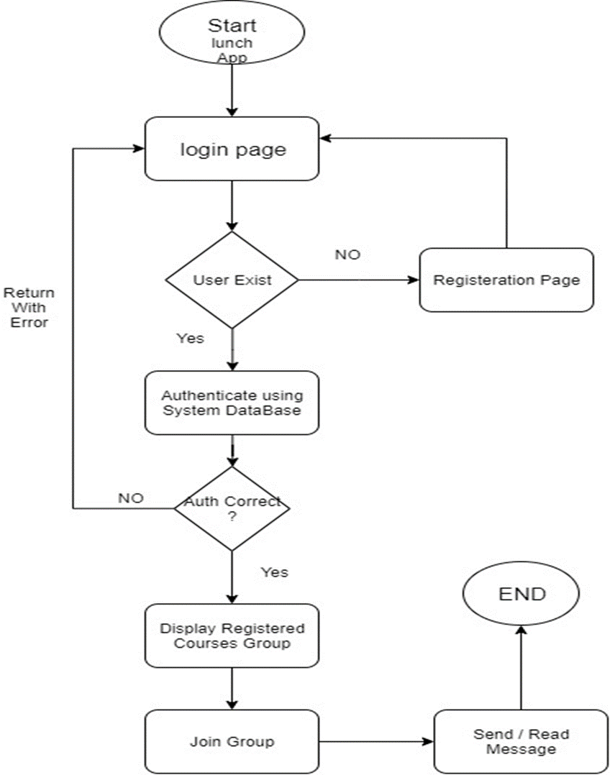
FLOWCHART DIAGRAM
Which show how the system works

Slide 10
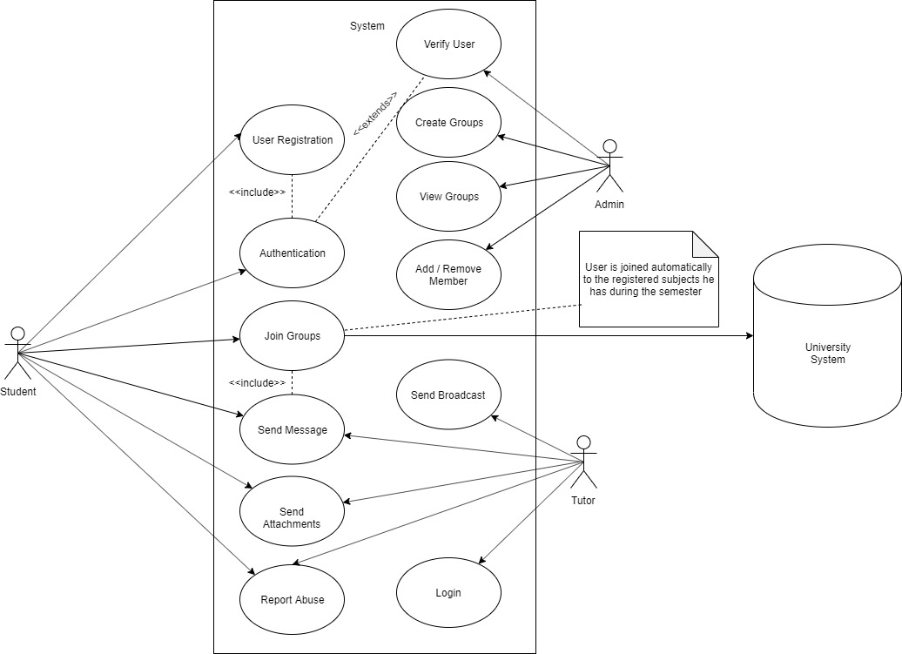
USE CASE DIAGRAM
That Shows how the system works

Slide 11
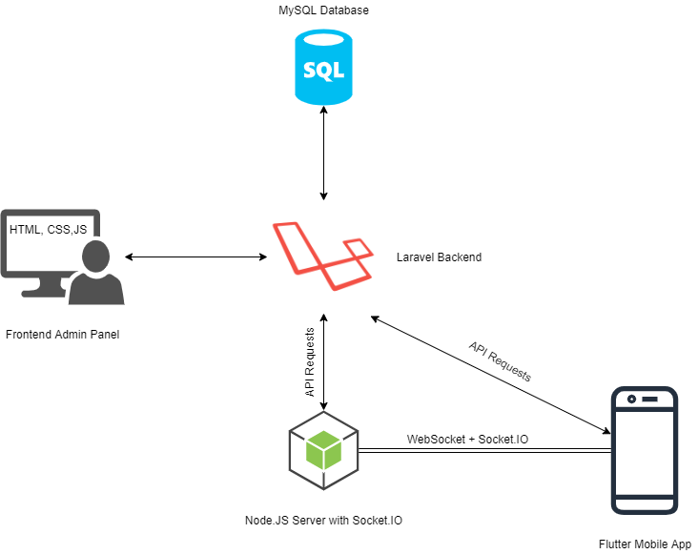
System Components

Slide 12
UGCA Platform
System Demo
Ai
We will make a small demo of the system as follow
1- Web Application
2- Chat Server
3- Mobile App
Ps

Slide 13
Closing Statement
Your Great Subtitle Here
This project is the first step to a real project that is going to improve students communications and learning.
We will Insha’a Allah work on it more to improve it even better and deploy more features.

